Slide 1
IT 356: Introduction To Computer Graphics (Lecture 22)
School of Information Technology
Illinois State University
Dr. Qi Zhang, Spring 2024

Slide 2
Lighting Maps

Slide 3
Introduction
We have discussed the possibility of each object having a unique material of its own that reacts differently to light.
This is great for giving each object a unique look in comparison with other objects in a lighted scene
It is still doesn't offer too much flexibility on the visual output of an object.

Slide 4
Introduction
In the last lecture, we defined a material for an entire object as a whole, but objects in the real world usually do not consist of a single material
Objects usually consist of several materials.
Think of a car: its exterior consists of a shiny fabric, it has windows that partly reflect the surrounding environment, its tires are all but shiny, so they don't have specular highlights, and it has super shiny rims.

Slide 5
Introduction
The car has diffuse and ambient colors that are not the same for the entire object
A car displays many different ambient/diffuse colors.
Such an object as a car has different material properties for each part.

Slide 6
Diffuse and Specular Maps
The material system we have learned so far isn't sufficient for all but the simplest models
We need to extend the previous system by introducing diffuse and specular maps.
These allow us to influence the diffuse (and indirectly the ambient component since they're almost always the same anyway) and the specular component of an object with much more precision.

Slide 7
Diffuse Maps
What we want is some way to set the diffuse color of an object for each fragment.
Some sort of system where we can retrieve a color value based on the fragment's position on the object.

Slide 8
Diffuse Maps
It basically is just a texture.
We're just using a different name for the same underlying principle: using an image wrapped around an object that we can index for unique color values per fragment.
In lighted scenes, this is usually called a diffuse map (generally how 3D artists call them) since a texture image represents all of the object's diffuse colors.

Slide 9
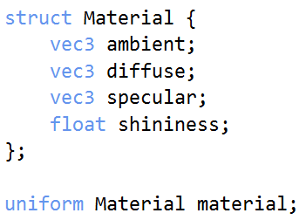
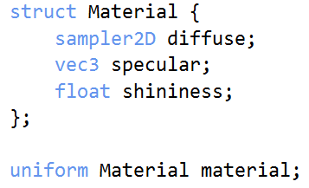
Diffuse Maps
Using a diffuse map in shaders is exactly the same as with the texture.
This time we store the texture as a sampler2D inside the Material struct.
We replace the earlier defined vec3 diffuse color vector with the diffuse map.

Slide 10
Sampler (GLSL)
A sampler is a set of GLSL variable types.
Variables of one of the sampler types must be uniforms.
Each sampler in a program represents a single texture of a particular texture type.
The type of the sampler corresponds to the type of texture that that sampler can use.
https://www.khronos.org/opengl/wiki/Sampler_(GLSL)

Slide 11
Diffuse Maps
Sampler2D is a so-called opaque type, which means we can't instantiate these types, only define them as uniforms.
If we instantiate this struct other than as a uniform (like a function parameter), GLSL could throw strange errors.
The same rule applies to any struct holding such opaque types.

Slide 12
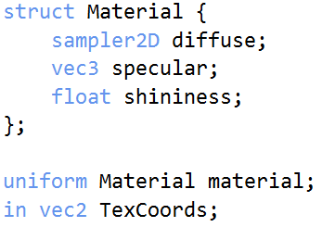
Diffuse Maps
We also remove the ambient material color vector.
Because the ambient color is, in almost all cases, equal to the diffuse color, so there's no need to store it separately.

Slide 13
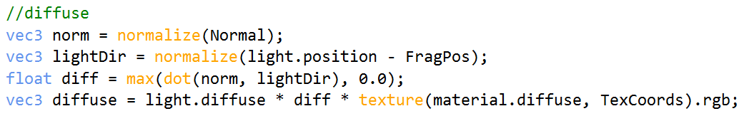
Diffuse Maps
We are going to need texture coordinates again in the fragment shader, so we declared an extra input variable, TexCoords.
Then we simply sample from the texture to retrieve the fragment's diffuse color value:

Slide 14
Diffuse Maps
Don't forget to set the ambient material's color equal to the diffuse material's color.
That's all it takes to use a diffuse map.

Slide 15
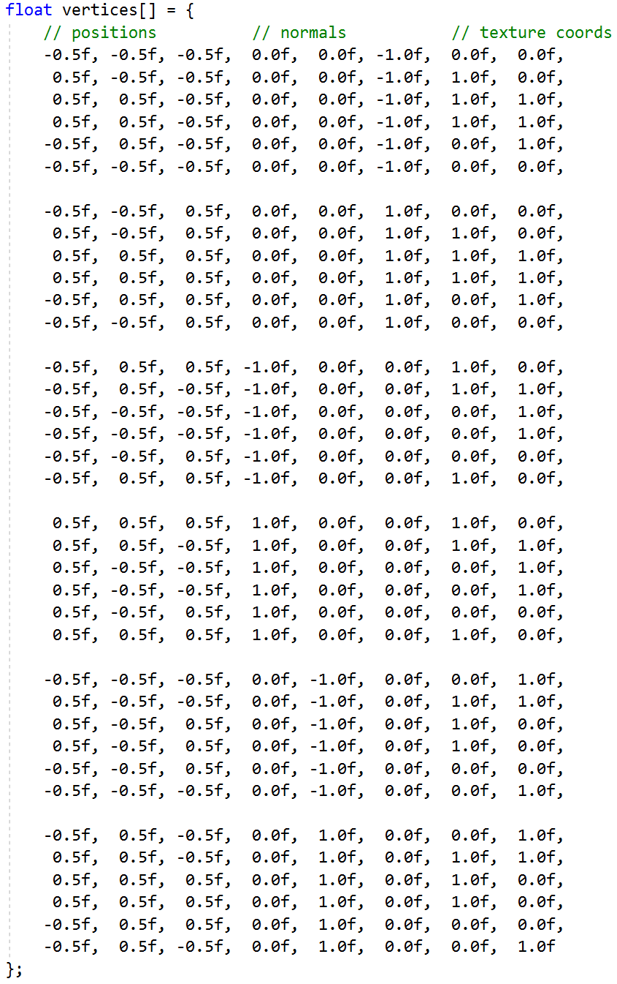
Diffuse Maps
To get diffuse map work, we need to update the vertex data with texture coordinates.
Transfer them as vertex attributes to the fragment shader.
Load the texture and bind the texture to the appropriate texture unit.

Slide 16
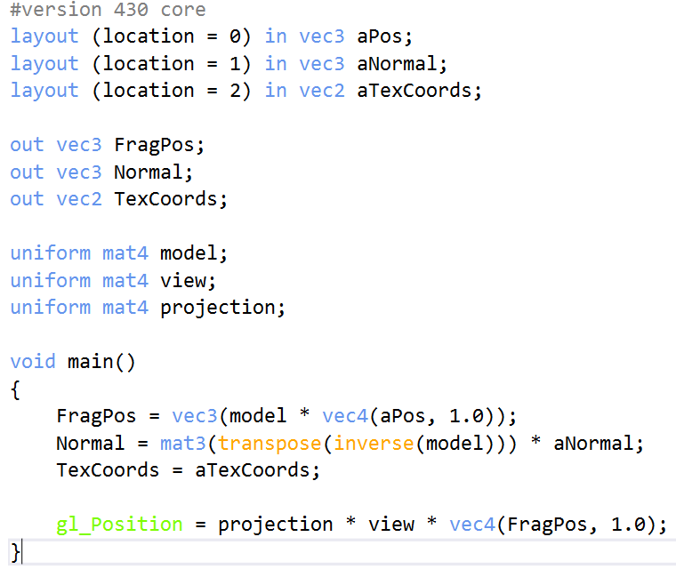
Updated Vertex Shader
The vertex data now includes vertex positions, normal vectors, and texture coordinates for each cube's vertices.
Let's update the vertex shader to accept texture coordinates as a vertex attribute and forward them to the fragment shader:
4.1.lighting_maps.vert

Slide 17
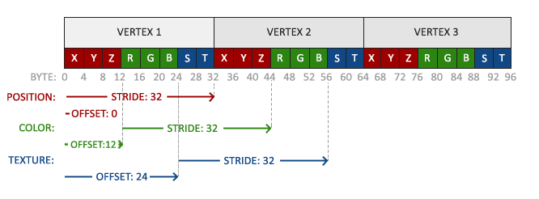
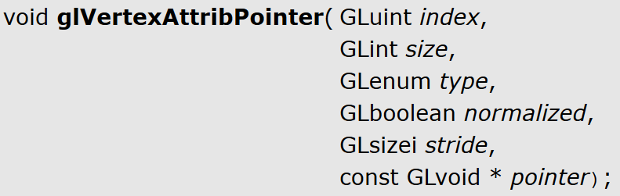
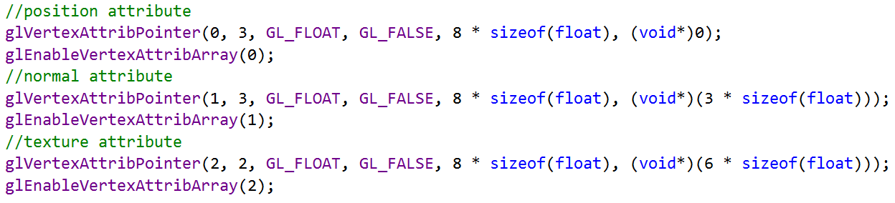
Vertex Attribute Pointers
Be sure to update the vertex attribute pointers of both VAOs to match the new vertex data and load the container image as a texture.
Stride: Specifies the byte offset between consecutive generic vertex attributes.

Slide 18
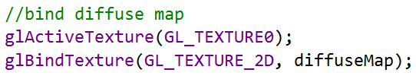
Assign Texture Unit
Before drawing the container, we want to assign the preferred texture unit to the material.diffuse uniform sampler and bind the container texture to this texture unit:

Slide 19
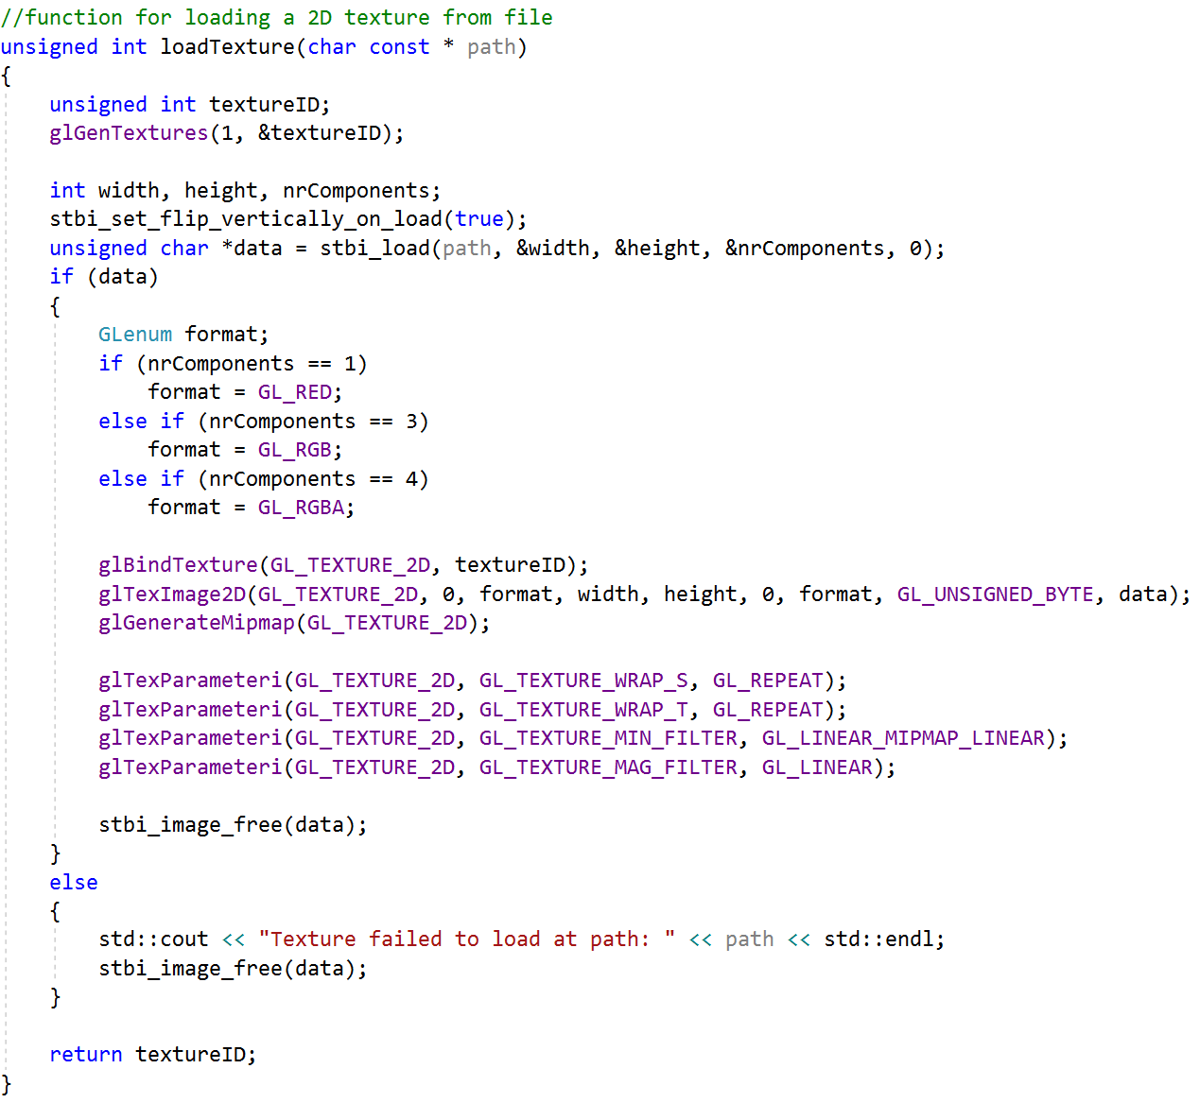
Load Texture

Slide 20
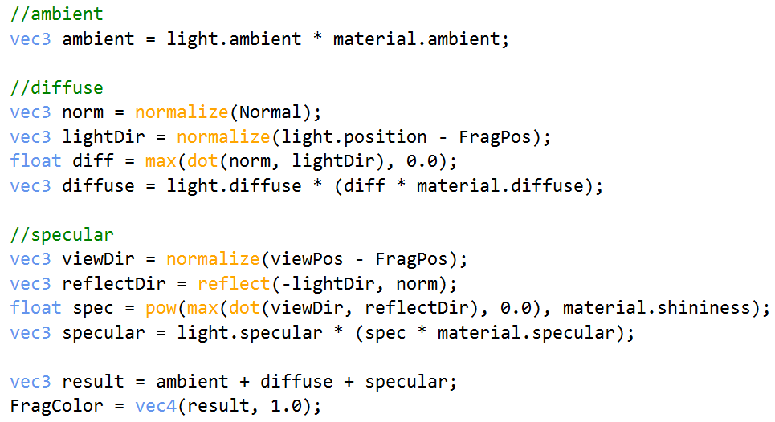
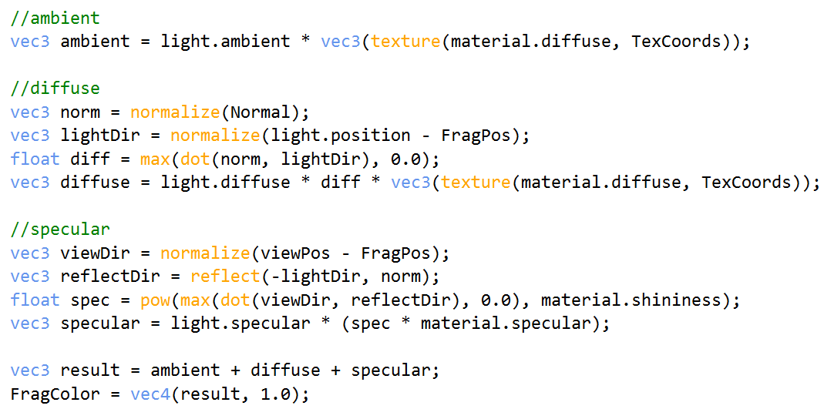
3.1.materials.frag
4.1.lighting_maps.frag

Slide 21
Example: Cube’s VAO and VBO
//The cube's VAO (and VBO)
//Vertex Buffer Object (VBO)
unsigned int VBO;
//Vertex Array Object (VAO)
unsigned int cubeVAO;
unsigned int lightVAO;

Slide 22
Shader Program Ids and Camera
//Shader Program (shaderProgram)'s ID
unsigned int lightingShader;
unsigned int lampShader;
//camera
Camera camera(glm::vec3(0.0f, 0.0f, 3.0f));

Slide 23
Lighting Position
//lighting
glm::vec3 lightPos;
float lightPosx, lightPosy, lightPosz;

Slide 24
Diffuse Map and Rotation Control Variables
//Diffuse map and rotation control variables
unsigned int diffuseMap;
bool rotFlg1;
float angle;

Slide 25
Set the Shader Program ID
//Return shaderProgram, which is used to set the shader program's ID
lightingShader = loadShader("../../src/shader/4.1.lighting_maps.vert", "../../src/shader/4.1.lighting_maps.frag");
lampShader = loadShader("../../src/shader/4.1.lamp.vert", "../../src/shader/4.1.lamp.frag");

Slide 26
Cube Vertex Shader: 4.1.lighting_maps.vert
#version 460 core
layout (location = 0) in vec3 aPos;
layout (location = 1) in vec3 aNormal;
layout (location = 2) in vec2 aTexCoords;
out vec3 FragPos;
out vec3 Normal;
out vec2 TexCoords;
uniform mat4 model;
uniform mat4 view;
uniform mat4 projection;
void main()
{
FragPos = vec3(model * vec4(aPos, 1.0));
Normal = mat3(transpose(inverse(model))) * aNormal;
TexCoords = aTexCoords;
gl_Position = projection * view * vec4(FragPos, 1.0);
}

Slide 27
Cube Fragment Shader: 4.1.lighting_maps.frag
#version 460 core
out vec4 FragColor;
struct Material {
sampler2D diffuse;
vec3 specular;
float shininess;
};
uniform Material material;
in vec2 TexCoords;
struct Light {
vec3 position;
vec3 ambient;
vec3 diffuse;
vec3 specular;
};
uniform Light light;
in vec3 FragPos;
in vec3 Normal;
uniform vec3 viewPos;

Slide 28
Cube Fragment Shader: 4.1.lighting_maps.frag
void main()
{
//ambient
vec3 ambient = light.ambient * vec3(texture(material.diffuse, TexCoords));
//diffuse
vec3 norm = normalize(Normal);
vec3 lightDir = normalize(light.position - FragPos);
float diff = max(dot(norm, lightDir), 0.0);
vec3 diffuse = light.diffuse * diff * vec3(texture(material.diffuse, TexCoords));
//specular
vec3 viewDir = normalize(viewPos - FragPos);
vec3 reflectDir = reflect(-lightDir, norm);
float spec = pow(max(dot(viewDir, reflectDir), 0.0), material.shininess);
vec3 specular = light.specular * (spec * material.specular);
vec3 result = ambient + diffuse + specular;
FragColor = vec4(result, 1.0);
}

Slide 29
Lamp Vertex Shader: 4.1.lamp.vert
#version 460 core
layout (location = 0) in vec3 aPos;
uniform mat4 model;
uniform mat4 view;
uniform mat4 projection;
void main()
{
gl_Position = projection * view * model * vec4(aPos, 1.0);
}

Slide 30
Lamp Fragment Shader: 4.1.lamp.frag
#version 460 core
out vec4 FragColor;
void main()
{
FragColor = vec4(1.0); // set alle 4 vector values to 1.0
}

Slide 31
Set Vertex Data
//set up vertex data (and buffer(s)) and configure vertex attributes
float vertices[] = {
//positions //normals //texture coords
-0.5f, -0.5f, -0.5f, 0.0f, 0.0f, -1.0f, 0.0f, 0.0f,
0.5f, -0.5f, -0.5f, 0.0f, 0.0f, -1.0f, 1.0f, 0.0f,
0.5f, 0.5f, -0.5f, 0.0f, 0.0f, -1.0f, 1.0f, 1.0f,
0.5f, 0.5f, -0.5f, 0.0f, 0.0f, -1.0f, 1.0f, 1.0f,
-0.5f, 0.5f, -0.5f, 0.0f, 0.0f, -1.0f, 0.0f, 1.0f,
-0.5f, -0.5f, -0.5f, 0.0f, 0.0f, -1.0f, 0.0f, 0.0f,
-0.5f, -0.5f, 0.5f, 0.0f, 0.0f, 1.0f, 0.0f, 0.0f,
0.5f, -0.5f, 0.5f, 0.0f, 0.0f, 1.0f, 1.0f, 0.0f,
0.5f, 0.5f, 0.5f, 0.0f, 0.0f, 1.0f, 1.0f, 1.0f,
0.5f, 0.5f, 0.5f, 0.0f, 0.0f, 1.0f, 1.0f, 1.0f,
-0.5f, 0.5f, 0.5f, 0.0f, 0.0f, 1.0f, 0.0f, 1.0f,
-0.5f, -0.5f, 0.5f, 0.0f, 0.0f, 1.0f, 0.0f, 0.0f,
-0.5f, 0.5f, 0.5f, -1.0f, 0.0f, 0.0f, 1.0f, 0.0f,
-0.5f, 0.5f, -0.5f, -1.0f, 0.0f, 0.0f, 1.0f, 1.0f,
-0.5f, -0.5f, -0.5f, -1.0f, 0.0f, 0.0f, 0.0f, 1.0f,
-0.5f, -0.5f, -0.5f, -1.0f, 0.0f, 0.0f, 0.0f, 1.0f,
-0.5f, -0.5f, 0.5f, -1.0f, 0.0f, 0.0f, 0.0f, 0.0f,
-0.5f, 0.5f, 0.5f, -1.0f, 0.0f, 0.0f, 1.0f, 0.0f,
0.5f, 0.5f, 0.5f, 1.0f, 0.0f, 0.0f, 1.0f, 0.0f,
0.5f, 0.5f, -0.5f, 1.0f, 0.0f, 0.0f, 1.0f, 1.0f,
0.5f, -0.5f, -0.5f, 1.0f, 0.0f, 0.0f, 0.0f, 1.0f,
0.5f, -0.5f, -0.5f, 1.0f, 0.0f, 0.0f, 0.0f, 1.0f,
0.5f, -0.5f, 0.5f, 1.0f, 0.0f, 0.0f, 0.0f, 0.0f,
0.5f, 0.5f, 0.5f, 1.0f, 0.0f, 0.0f, 1.0f, 0.0f,
-0.5f, -0.5f, -0.5f, 0.0f, -1.0f, 0.0f, 0.0f, 1.0f,
0.5f, -0.5f, -0.5f, 0.0f, -1.0f, 0.0f, 1.0f, 1.0f,
0.5f, -0.5f, 0.5f, 0.0f, -1.0f, 0.0f, 1.0f, 0.0f,
0.5f, -0.5f, 0.5f, 0.0f, -1.0f, 0.0f, 1.0f, 0.0f,
-0.5f, -0.5f, 0.5f, 0.0f, -1.0f, 0.0f, 0.0f, 0.0f,
-0.5f, -0.5f, -0.5f, 0.0f, -1.0f, 0.0f, 0.0f, 1.0f,
-0.5f, 0.5f, -0.5f, 0.0f, 1.0f, 0.0f, 0.0f, 1.0f,
0.5f, 0.5f, -0.5f, 0.0f, 1.0f, 0.0f, 1.0f, 1.0f,
0.5f, 0.5f, 0.5f, 0.0f, 1.0f, 0.0f, 1.0f, 0.0f,
0.5f, 0.5f, 0.5f, 0.0f, 1.0f, 0.0f, 1.0f, 0.0f,
-0.5f, 0.5f, 0.5f, 0.0f, 1.0f, 0.0f, 0.0f, 0.0f,
-0.5f, 0.5f, -0.5f, 0.0f, 1.0f, 0.0f, 0.0f, 1.0f
};

Slide 32
Configure Cube’s VAO and VBO
//first, configure the cube's VAO (and VBO)
glGenVertexArrays(1, &cubeVAO);
glGenBuffers(1, &VBO);
glBindBuffer(GL_ARRAY_BUFFER, VBO);
glBufferData(GL_ARRAY_BUFFER, sizeof(vertices), vertices, GL_STATIC_DRAW);
glBindVertexArray(cubeVAO);
//position attribute
glVertexAttribPointer(0, 3, GL_FLOAT, GL_FALSE, 8 * sizeof(float), (void*)0);
glEnableVertexAttribArray(0);
//normal attribute
glVertexAttribPointer(1, 3, GL_FLOAT, GL_FALSE, 8 * sizeof(float), (void*)(3 * sizeof(float)));
glEnableVertexAttribArray(1);
//texture attribute
glVertexAttribPointer(2, 2, GL_FLOAT, GL_FALSE, 8 * sizeof(float), (void*)(6 * sizeof(float)));
glEnableVertexAttribArray(2);

Slide 33
Configure Light’s VAO and VBO
//second, configure the light's VAO (VBO stays the same;
//the vertices are the same for the light object which is also a 3D cube)
glGenVertexArrays(1, &lightVAO);
glBindVertexArray(lightVAO);
glBindBuffer(GL_ARRAY_BUFFER, VBO);
//note that we update the lamp's position attribute's stride
//to reflect the updated buffer data
glVertexAttribPointer(0, 3, GL_FLOAT, GL_FALSE, 8 * sizeof(float), (void*)0);
glEnableVertexAttribArray(0);

Slide 34
Load Textures and Material Diffuse
//Load textures
diffuseMap = loadTexture("../../src/resources/textures/container2.png");
//Load material diffuse
glUseProgram(lightingShader);
unsigned int materialDiffuseLoc = glGetUniformLocation(lightingShader, "material.diffuse");
glUniform1i(materialDiffuseLoc, 0);

Slide 35
//function for loading a 2D texture from file
unsigned int loadTexture(char const * path)
{
unsigned int textureID;
glGenTextures(1, &textureID);
int width, height, nrComponents;
stbi_set_flip_vertically_on_load(true);
unsigned char *data = stbi_load(path, &width, &height, &nrComponents, 0);
if (data) {
GLenum format = GL_RGB;
if (nrComponents == 1)
format = GL_RED;
else if (nrComponents == 3)
format = GL_RGB;
else if (nrComponents == 4)
format = GL_RGBA;
glBindTexture(GL_TEXTURE_2D, textureID);
glTexImage2D(GL_TEXTURE_2D, 0, format, width, height, 0, format, GL_UNSIGNED_BYTE, data);
glGenerateMipmap(GL_TEXTURE_2D);
glTexParameteri(GL_TEXTURE_2D, GL_TEXTURE_WRAP_S, GL_REPEAT);
glTexParameteri(GL_TEXTURE_2D, GL_TEXTURE_WRAP_T, GL_REPEAT);
glTexParameteri(GL_TEXTURE_2D, GL_TEXTURE_MIN_FILTER, GL_LINEAR_MIPMAP_LINEAR);
glTexParameteri(GL_TEXTURE_2D, GL_TEXTURE_MAG_FILTER, GL_LINEAR);
stbi_image_free(data);
}
else {
std::cout << "Texture failed to load at path: " << path << std::endl;
stbi_image_free(data);
}
return textureID;
}

Slide 36
Set Initial Variable Values
//Set initial variable values for rotation control and lighting position
rotFlg1 = false;
angle = 0.0f;
lightPosx = 1.2f;
lightPosy = 0.5f;
lightPosz = 2.0f;

Slide 37
Active Shader for the Cube
//Activate shader for the cube
//be sure to activate the shader when setting uniforms/drawing objects
glUseProgram(lightingShader);

Slide 38
Lighting and Viewing Positions
//Lighting position
lightPos = glm::vec3(lightPosx, lightPosy, lightPosz);
unsigned int lightPosLoc = glGetUniformLocation(lightingShader, "light.position");
glUniform3f(lightPosLoc, lightPos.x, lightPos.y, lightPos.z);
//Viewing position
unsigned int cameraPosLoc = glGetUniformLocation(lightingShader, "viewPos");
glUniform3f(cameraPosLoc, camera.Position.x, camera.Position.y, camera.Position.z);

Slide 39
Lighting Properties
//light properties
unsigned int ambientColorLoc = glGetUniformLocation(lightingShader, "light.ambient");
glUniform3f(ambientColorLoc, 0.2f, 0.2f, 0.2f);
unsigned int diffuseColorLoc = glGetUniformLocation(lightingShader, "light.diffuse");
//darken the light a bit to fit the scene
glUniform3f(diffuseColorLoc, 0.5f, 0.5f, 0.5f);
unsigned int specularColorLoc = glGetUniformLocation(lightingShader, "light.specular");
glUniform3f(specularColorLoc, 1.0f, 1.0f, 1.0f);

Slide 40
Material Properties
//material properties
//specular lighting doesn't have full effect on this object's material
unsigned int materialSpecularLoc = glGetUniformLocation(lightingShader, "material.specular");
glUniform3f(materialSpecularLoc, 0.5f, 0.5f, 0.5f);
unsigned int materialShininessLoc = glGetUniformLocation(lightingShader, "material.shininess");
glUniform1f(materialShininessLoc, 64.0f);

Slide 41
View and Projection Transformations
//view and projection transformations
glm::mat4 projection = glm::perspective(glm::radians(camera.Zoom), (float)SCR_WIDTH / (float)SCR_HEIGHT, 0.1f, 100.0f);
glm::mat4 view = camera.GetViewMatrix();
unsigned int projectionLoc = glGetUniformLocation(lightingShader, "projection");
glUniformMatrix4fv(projectionLoc, 1, GL_FALSE, glm::value_ptr(projection));
unsigned int viewLoc = glGetUniformLocation(lightingShader, "view");
glUniformMatrix4fv(viewLoc, 1, GL_FALSE, glm::value_ptr(view));

Slide 42
World Transformation
//world transformation
glm::mat4 model = glm::mat4(1.0f);
//model = glm::scale(model1, glm::vec3(1.0f));
if (rotFlg1)
{
angle = (float)glfwGetTime()/2.0;
model = glm::rotate(model, angle, glm::vec3(0.0f, 1.0f, 0.0f));
}
else {
model = glm::rotate(model, angle, glm::vec3(0.0f, 1.0f, 0.0f));
}
unsigned int modelLoc = glGetUniformLocation(lightingShader, "model");
glUniformMatrix4fv(modelLoc, 1, GL_FALSE, glm::value_ptr(model));

Slide 43
Bind Diffuse Map and Render Cube
//bind diffuse map
glActiveTexture(GL_TEXTURE0);
glBindTexture(GL_TEXTURE_2D, diffuseMap);
//render the cube
glBindVertexArray(cubeVAO);
glDrawArrays(GL_TRIANGLES, 0, 36);

Slide 44
Active Shader for Lamp
//Active shader for the lamp
//also draw the lamp object
glUseProgram(lampShader);

Slide 45
View and Projection Transformations
//view and projection transformations
projectionLoc = glGetUniformLocation(lampShader, "projection");
glUniformMatrix4fv(projectionLoc, 1, GL_FALSE, glm::value_ptr(projection));
viewLoc = glGetUniformLocation(lampShader, "view");
glUniformMatrix4fv(viewLoc, 1, GL_FALSE, glm::value_ptr(view));

Slide 46
World Transformation
//world transformation
model = glm::mat4(1.0f);
model = glm::translate(model, lightPos);
model = glm::scale(model, glm::vec3(0.2f)); // a smaller cube
modelLoc = glGetUniformLocation(lampShader, "model");
glUniformMatrix4fv(modelLoc, 1, GL_FALSE, glm::value_ptr(model));

Slide 47
Render the Lamp
//render the lamp
glBindVertexArray(lightVAO);
glDrawArrays(GL_TRIANGLES, 0, 36);

Slide 48
Release Used Resources
//Optional: de-allocate all resources once they've outlived their purpose:
glDeleteVertexArrays(1, &cubeVAO);
glDeleteVertexArrays(1, &lightVAO);
glDeleteBuffers(1, &VBO);

Slide 49
Key Controls Movement
if (glfwGetKey(window, GLFW_KEY_W) == GLFW_PRESS)
camera.ProcessKeyboard(FORWARD, deltaTime);
if (glfwGetKey(window, GLFW_KEY_S) == GLFW_PRESS)
camera.ProcessKeyboard(BACKWARD, deltaTime);
if (glfwGetKey(window, GLFW_KEY_A) == GLFW_PRESS)
camera.ProcessKeyboard(LEFT, deltaTime);
if (glfwGetKey(window, GLFW_KEY_D) == GLFW_PRESS)
camera.ProcessKeyboard(RIGHT, deltaTime);
if (glfwGetKey(window, GLFW_KEY_R) == GLFW_PRESS) {
rotFlg1 = true;
}
else if (glfwGetKey(window, GLFW_KEY_P) == GLFW_PRESS) {
rotFlg1 = false;
}
if (glfwGetKey(window, GLFW_KEY_M) == GLFW_PRESS) {
lightPosy += 0.002;
}
if (glfwGetKey(window, GLFW_KEY_N) == GLFW_PRESS) {
lightPosy -= 0.002;
}
if (glfwGetKey(window, GLFW_KEY_K) == GLFW_PRESS) {
lightPosz += 0.002;
}
if (glfwGetKey(window, GLFW_KEY_L) == GLFW_PRESS) {
lightPosz -= 0.002;
}
if (glfwGetKey(window, GLFW_KEY_I) == GLFW_PRESS) {
lightPosx += 0.002;
}
if (glfwGetKey(window, GLFW_KEY_J) == GLFW_PRESS) {
lightPosx -= 0.002;
}

Slide 50
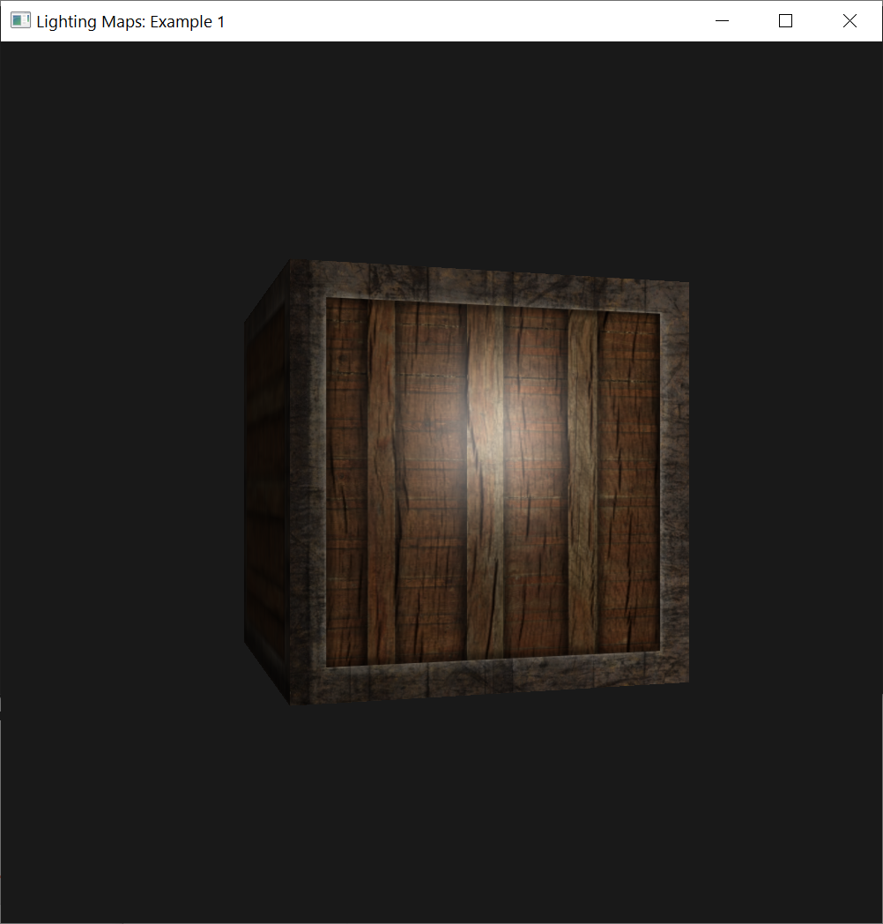
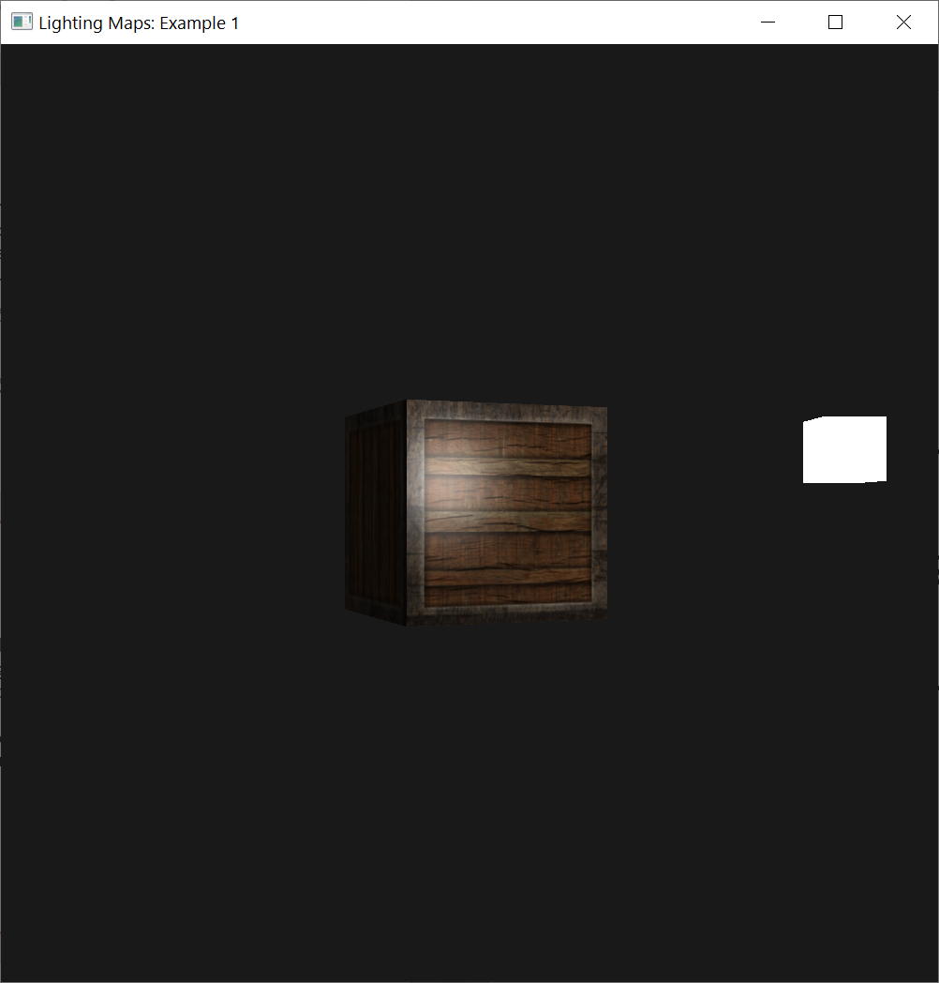
Running Result
Using a diffuse map, we get great details and add lighting to the container.

Slide 51
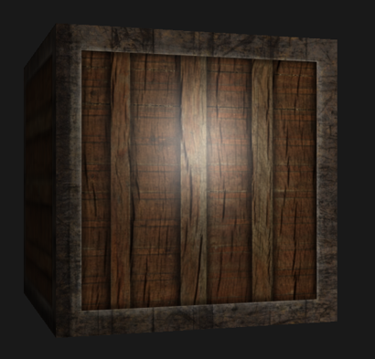
Specular Maps
You probably noticed that the specular highlight looks a bit off
Because our object is a container that mostly consists of wood, and we know that wood doesn't give such specular highlights.

Slide 52
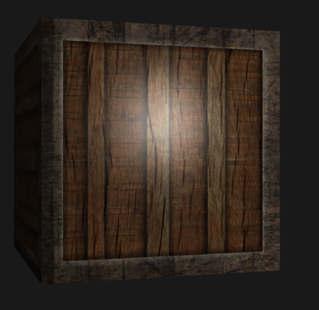
Specular Maps
We can fix this by setting the specular material of the object to vec3(0.0).
But that would mean that the steel borders of the container would stop showing specular highlights as well
We also know that steel should show some specular highlights.

Slide 53
Specular Maps
We would like to control what parts of the object should show a specular highlight with varying intensity.
This is a problem that looks really familiar to the diffuse map discussion.

Slide 54
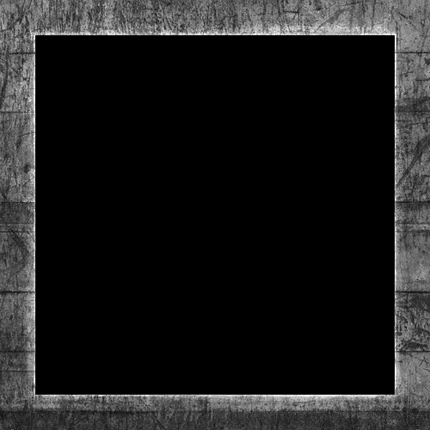
Specular Maps
We can use a texture map just for specular highlights.
This means we need to generate a black-and-white (or colors if you feel like it) texture that defines the specular intensities of each part of the object.
An example of a specular map is the right image:

Slide 55
Specular Maps
The intensity of a specular highlight is retrieved by the brightness of each pixel in the image.
Each pixel of the specular map can be displayed as a color vector where black represents the color vector vec3(0.0) and gray represents the color vector vec3(0.5) for example.

Slide 56
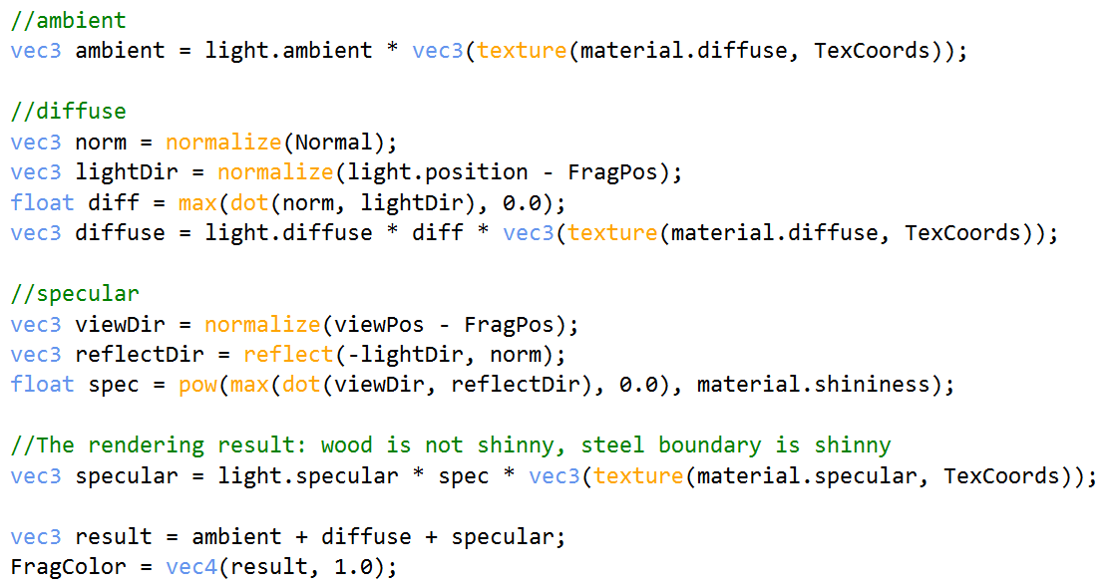
Specular Maps
In the fragment shader, we then sample the corresponding color value and multiply this value with the light's specular intensity.
The 'whiter' a pixel thus is, the higher the result of the multiplication and thus the brighter the specular component of an object becomes.
4.2.lighting_maps.frag

Slide 57
Specular Maps
Because the container mostly consists of wood, and wood as a material should have no specular highlights, the entire wooden section of the diffuse texture was converted to black: black sections do not have any specular highlight.

Slide 58
Specular Maps
The steel border of the container has varying specular intensities with the steel itself being relatively susceptible to specular highlights while the cracks are not.

Slide 59
Specular Map Variable
//Specular map variable
unsigned int specularMap;

Slide 60
Load Texture for Specular Map
A specular map is just like any other texture, so the code is similar to the diffuse map code.
Make sure to load the image and generate a texture object properly.
//Load texture for specular map
specularMap = loadTexture("../../src/resources/textures/container2_specular.png");
//Load material specular
unsigned int materialSpecularLoc = glGetUniformLocation(lightingShader, "material.specular");
glUniform1i(materialSpecularLoc, 1);
////material properties
////specular lighting doesn't have full effect on this object's material
//unsigned int materialSpecularLoc = glGetUniformLocation(lightingShader, "material.specular");
//glUniform3f(materialSpecularLoc, 0.5f, 0.5f, 0.5f);

Slide 61
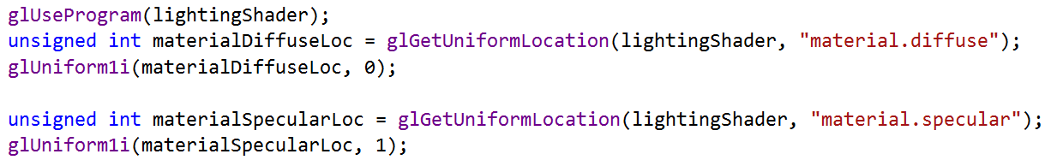
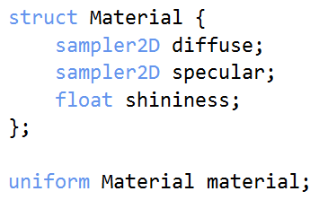
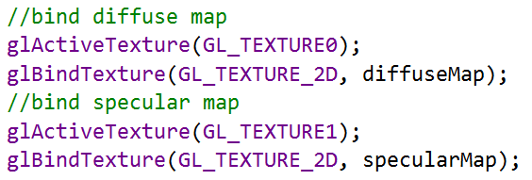
Bind Texture Unit
Make sure that sampler2D diffuse accept texture unit 0
Make sure that sampler2D specular accept texture unit 1
Texture unit 0
Texture unit 1

Slide 62
Bind Specular Map
//bind specular map
glActiveTexture(GL_TEXTURE1);
glBindTexture(GL_TEXTURE_2D, specularMap);
We're using another texture sampler in the same fragment shader. We have to use a different texture unit for the specular map
Then, we bind it to the appropriate texture unit before rendering:
Bind texture id diffuseMap with texture unit 0, i.e., GL_TEXTURE0
Bind texture id specularMap with texture unit 1, i.e., GL_TEXTURE1

Slide 63
Update Cube’s Fragment Shader
#version 460 core
out vec4 FragColor;
struct Material {
sampler2D diffuse;
sampler2D specular;
//vec3 specular;
float shininess;
};
uniform Material material;
in vec2 TexCoords;
struct Light {
vec3 position;
vec3 ambient;
vec3 diffuse;
vec3 specular;
};
uniform Light light;
in vec3 FragPos;
in vec3 Normal;
uniform vec3 viewPos;
Update the material properties of the fragment shader to accept a sampler2D as its specular component instead of a vec3:

Slide 64
Update Cube’s Fragment Shader
void main()
{
//ambient
vec3 ambient = light.ambient * vec3(texture(material.diffuse, TexCoords));
//diffuse
vec3 norm = normalize(Normal);
vec3 lightDir = normalize(light.position - FragPos);
float diff = max(dot(norm, lightDir), 0.0);
vec3 diffuse = light.diffuse * diff * vec3(texture(material.diffuse, TexCoords));
//specular
vec3 viewDir = normalize(viewPos - FragPos);
vec3 reflectDir = reflect(-lightDir, norm);
float spec = pow(max(dot(viewDir, reflectDir), 0.0), material.shininess);
//vec3 specular = light.specular * (spec * material.specular);
//The rendering result: wood is not shinny, steel boundary is shinny
vec3 specular = light.specular * spec * vec3(texture(material.specular, TexCoords));
vec3 result = ambient + diffuse + specular;
FragColor = vec4(result, 1.0);
}

Slide 65
Bind Texture Unit
Make sure that sampler2D diffuse accept texture unit 0
Make sure that sampler2D specular accept texture unit 1
Texture unit 0
Texture unit 1

Slide 66
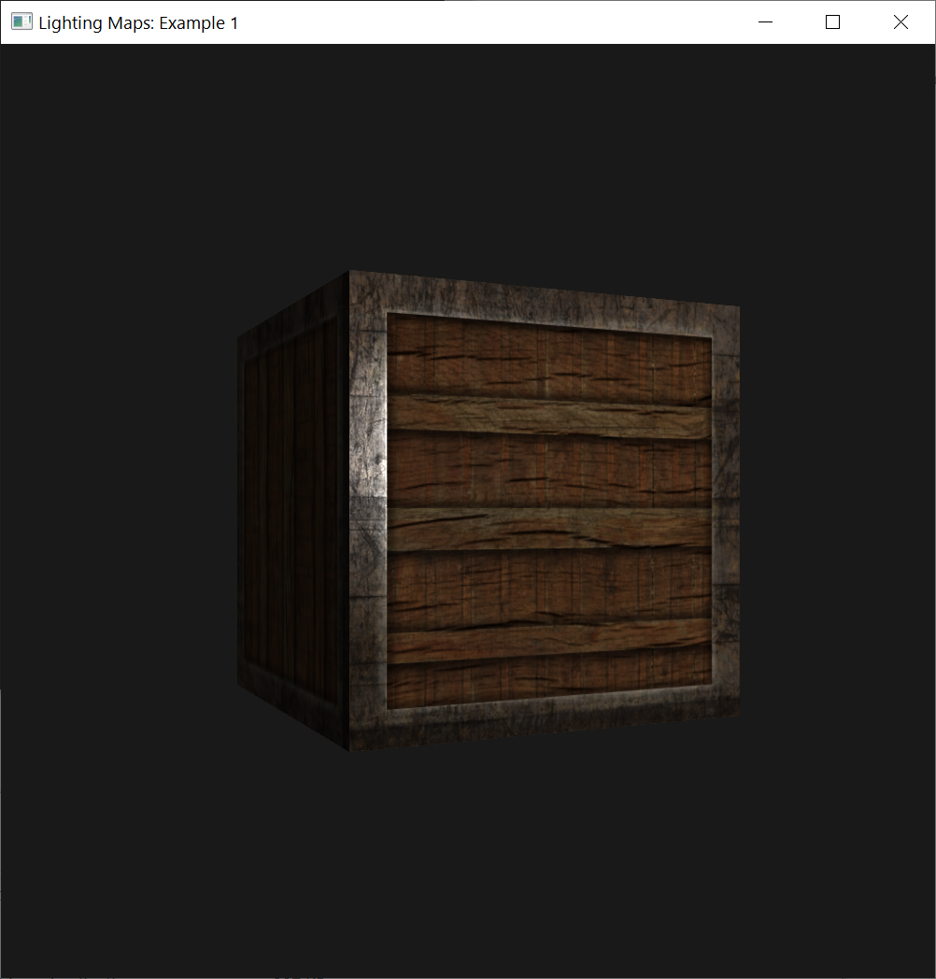
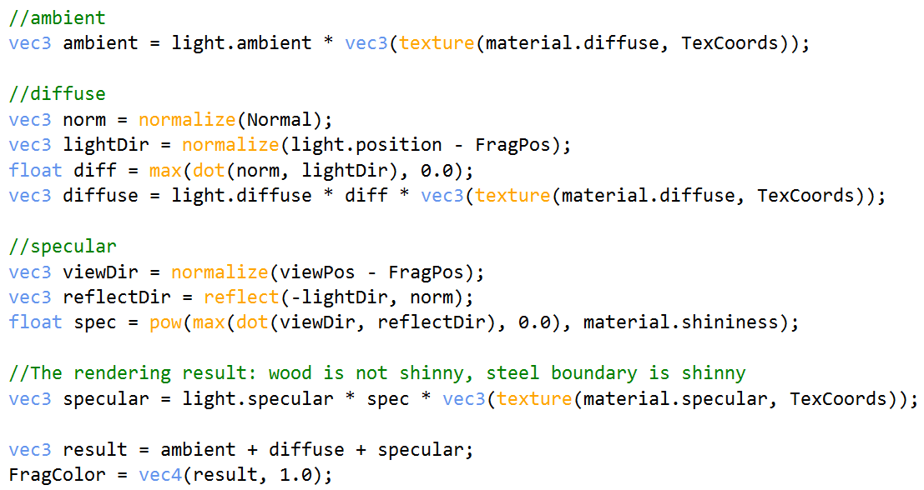
Updated Result
Run the application you can clearly see that the container's material now closely resembles that of an actual wooden container with steel frames:

Slide 67
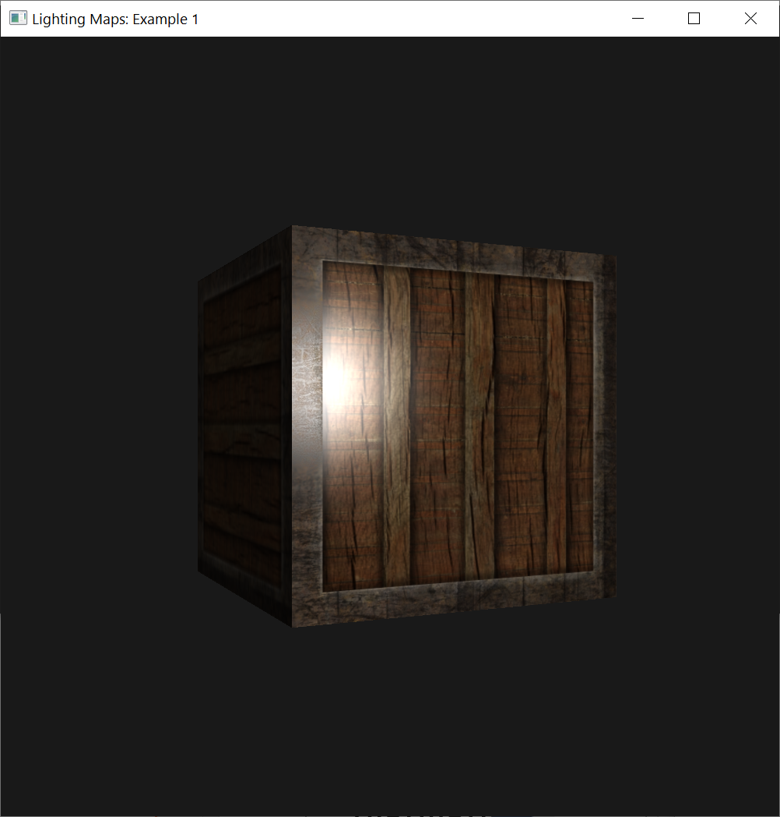
Exercise 1
Inverting the color values of the specular map in the fragment shader, so that the wood shows specular highlights and the steel borders do not
Due to the cracks in the steel border, the borders still show some specular highlight, although with less intensity

Slide 68
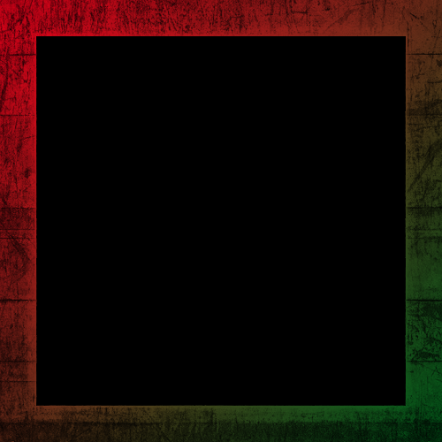
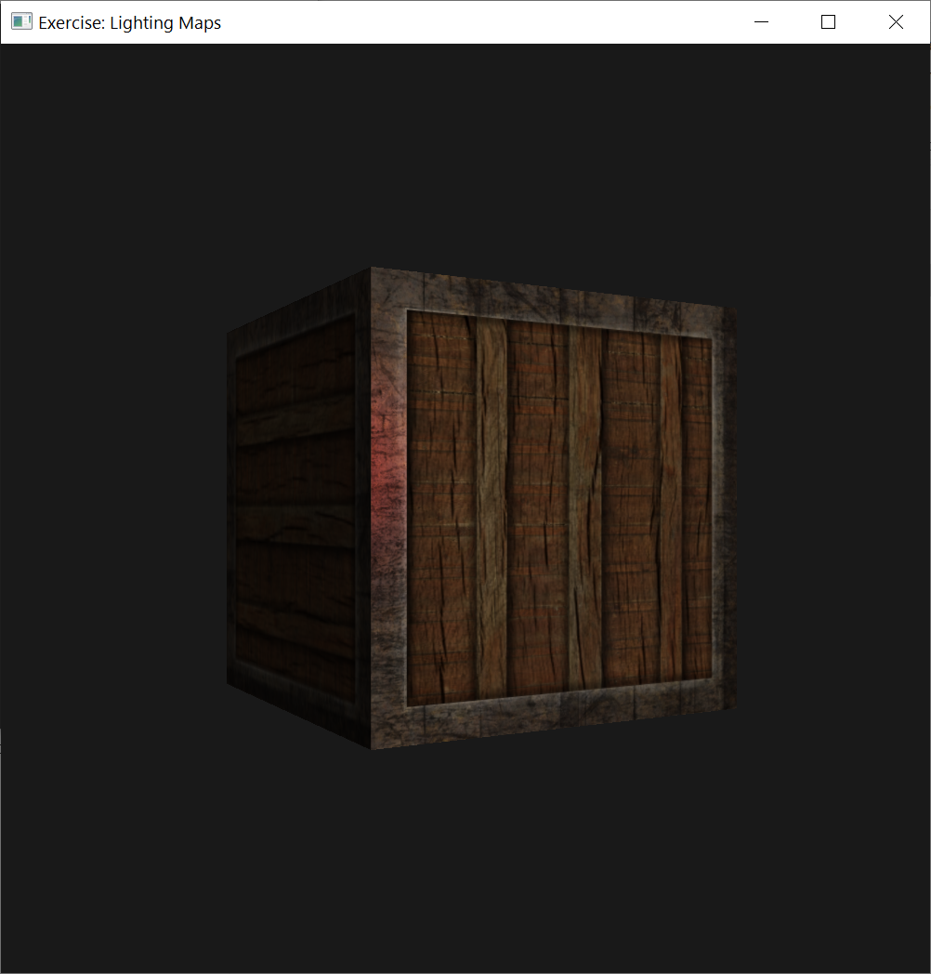
Exercise 2
Create a specular map from the diffuse texture that uses actual colors instead of black and white and see that the result doesn't look too realistic.

